Slide 1
Cryptographic System Standards
Chapter 4

Slide 2
Learning Objectives
By the end of this chapter, students should be able to discuss the following:
Virtual private network standards, including SSL/TLS VPNs; IPsec VPNs
Commercial WANs and MPLS VPNs
Wired LAN security standards
Wireless LAN (WLAN) security standards

Slide 3
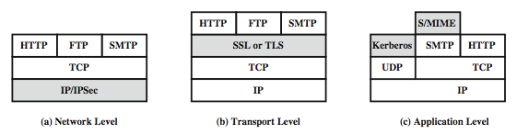
Relative Locations of Security Facilities in the TCP/IP Protocol Stack

Slide 4
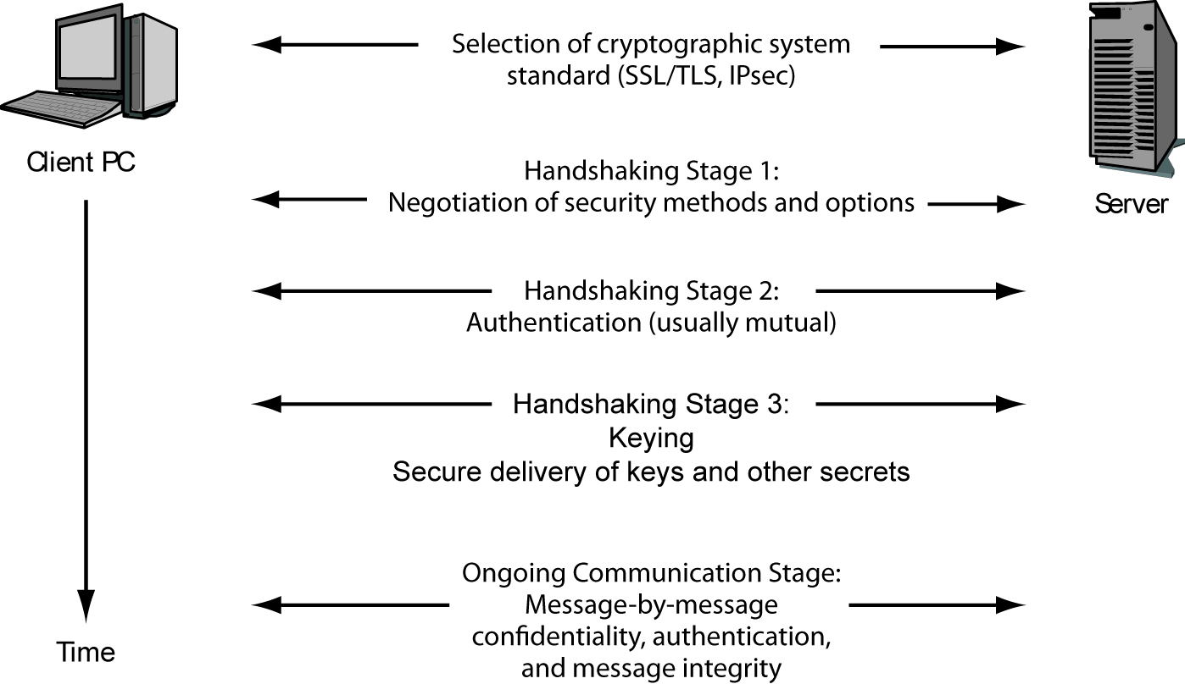
4-1: Cryptographic System

Slide 5
Virtual Private Networks (VPNs)
VPN is a cryptographic system that provides secure communication over an untrusted network.
Why VPN?
Protect data in transit
Private lines are expensive
Private lines are not fully utilized

Slide 6
Benefits of VPN
Cost
Cost saving by using the Internet
A VPN tunnel established between two end points
Flexibility
Rapid set-up possible
Some support Quality of Service (QoS)

Slide 7
Types of VPNs
Host-to-Host
Connects a single client over an untrusted network to a single server
Remote Access
Connects a single remote PC over an untrusted network to a site network
Site-to-Site
Protect all traffic flowing over an untrusted network between a pair of sites

Slide 8
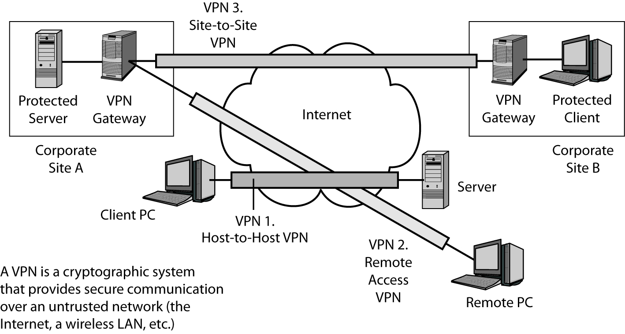
4-2: Virtual Private Networks (VPNs)

Slide 9
VPN Security
VPN is secure because it involves encryption?
Yes
Stop an attackers from eavesdropping
No
Encryption: reduces the effectiveness of security tools
Site-to-site: if the other side is a different org, then need to limit its traffic
Client-to-site: can the client trusted? (did install security tools?)

Slide 10
VPN Technologies
IPSec VPN
Designed for site-to-site VPNs
Remote access from a small finite number of tightly-controlled corporate assets.
SSL VPN
Increased productivity: Work in more places - home, kiosks, PDAs
Lower costs: SSL VPNs are clientless or use lightweight Web-delivered clients
Broadened security: SSL VPNs provide granular access and end point control to managed and non-managed devices
* Source: SonicWALL

Slide 11
SSL/TLS
Provide session encryption and integrity for client-server or server-server traffic
Can provide server authentication through X.509 certificates
SSL: Two components
SSL Handshake protocol: Sets up cryptographic parameters
SSL Record layer: Provides encryption services
TLS: Enhancement of SSL
* Wiley, 2008

Slide 12
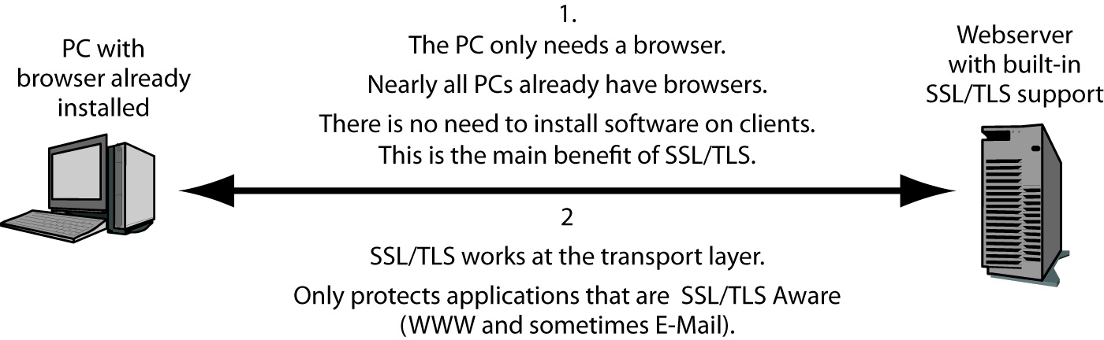
4-3: Host-to-Host SSL/TLS VPN (1)

Slide 13
4-3: Host-to-Host SSL/TLS VPN (2)
Non-Transparent Protection
Protects only SSL/TLS-aware applications (Web applications and e-mail) that have been specifically created to work with SSL/TLS
Inexpensive Operation
No setup on clients
Every computer has a browser, and all browsers are SSL/TLS aware
All webservers and most mail servers know how to work with SSL/TLS

Slide 14
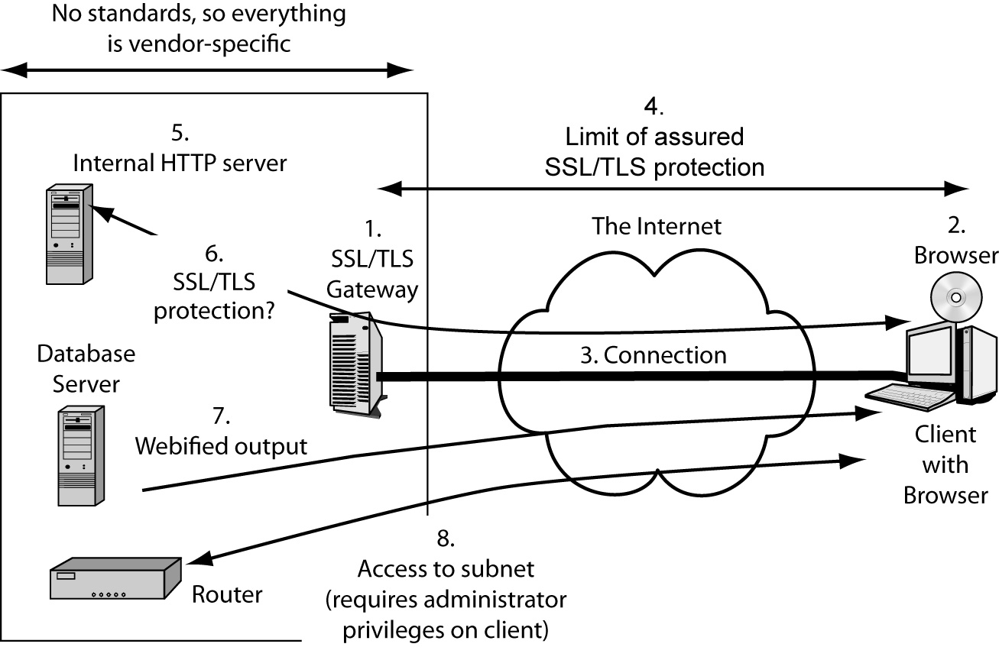
4-5: SSL/TLS Gateways and Remote Access VPNs (1)

Slide 15
4-5: SSL/TLS Gateways and Remote Access VPNs (2)
VPN gateway standards
An SSL/TLS gateway is simply a webserver. There is no need to add anything to the SSL/TLS standard
Authentication
Server authentication
Client authentication
Connecting client PC to authorized resources
Multiple internal webservers
Database server
An entire subnet

Slide 16
4-5: SSL/TLS Gateways and Remote Access VPNs (3)
Security for services
Security between the gateway and internal resources is up to a gateway vendor’s design choice
Browser on the client
Only a Web browser is necessary
Advanced services require admin privileges on PCs
Add-ins allow clients transparent access to a subnet and erase browsing history on a PC while traveling
Requires administrator access

Slide 17
4-5: SSL/TLS Gateways and Remote Access VPNs (4)
Perspective
Unstandardized SSL/TLS gateways. Using remote access VPNs requires strong due diligence in needs assessment and product analysis, as well as a significant interaction by the networking staff.
SSL/TLS can support the host-to-host and remote access VPNs. SSL/TLS cannot support site-to-site VPNs.

Slide 18
4-4: SSL/TLS Handshaking Phase
Step | Sender | Name of Message | Semantics (Meaning)
1 | Client | Client Hello | Client requests secure connection. Client lists cipher suites it supports.
2 | Server | Server Hello | Server indicates willingness to proceed. Selects a cipher suite to use in the session.
3 | Server | Certificate | Server sends its digital certificate containing its public key. (Client should check the certificate’s validity.)
4 | Server | ServerHelloDone | Server indicates that its part in the initial introduction is finished.

Slide 19
4-4: SSL/TLS Handshaking Phase
Key Exchange
using public key encryption for confidentiality
Step | Sender | Name of Message | Semantics (Meaning)
5 | Client | ClientKey Exchange | Client generates a random symmetric session key. Encrypts it with the server’s public key. It sends this encrypted key to the server. Only the server can decrypt the key, using the server’s own private key. The server decrypts the session key. Both sides now have the session key.
6 | Client | ChangeCipher Spec* | Client changes selected cipher suite from pending to active.
7 | Client | Finish | Client indicates that its part in the initial introduction is finished.
*Not cipher suite.

Slide 20
4-4: SSL/TLS Handshaking Phase
Step | Sender | Name of Message | Semantics (Meaning)
8 | Server | ChangeCipherSpec* | Server changes selected cipher suite from pending to active.
9 | Server | Finish | Server indicates that its role in selecting options is finished.
10 | Ongoing communication stage begins
*Not cipher suite.

Slide 21

SSL/TLS Vulnerabilities
BEAST (Browser Exploit Against SSL/TLS)
See the links below
SSL/TLS
Notes:
* Vulnerabilities:
- http://technet.microsoft.com/en-us/security/advisory/2588513
- http://www.infosecurity-magazine.com/view/21014/microsoft-warns-on-combination-ssltls-security-risk/
- http://www.h-online.com/security/news/item/Mozilla-considers-disabling-Java-in-Firefox-1351590.html
- http://www.computerworld.com/s/article/9220990/Oracle_patches_Java_flaw_exploited_in_SSL_BEAST_attack?taxonomyId=85
- http://www.computerworld.com/s/article/9220331/Microsoft_promises_patch_to_block_BEAST_attacks?taxonomyId=17
- http://www.theregister.co.uk/2011/09/19/beast_exploits_paypal_ssl/ - http://informationweek.com/news/security/vulnerabilities/231601759 - http://news.cnet.com/8301-30685_3-20108633-264/researchers-to-detail-hole-in-web-encryption/ - http://www.theregister.co.uk/2011/09/21/google_chrome_patch_for_beast/
- http://www.theregister.co.uk/2011/09/19/beast_exploits_paypal_ssl/

Slide 22
SSL/TLS Analysis using Wireshark
File name: https-justlaunchpage.pcap
Identify Cipher Suites available on client
Identify the selected cipher suite by server
Identify the public key
Notes:
http://en.wikipedia.org/wiki/Transport_Layer_Security#TLS_handshake_in_detail

Slide 23
Wireshark SSL/TLS Optional Assignment
See the posted doc

Slide 24
IP Security (IPsec) (1)
Operates at the Internet Layer; application-independent
Optional with IPv4, required with IPv6
Used to secure traffic on LAN or VPN
Can be configured for:
Confidentiality
Authentication
Data integrity
Packet filtering
Protection against data replay attacks
Can be configured to use multiple security algorithm options
* Wiley, 2008

Slide 25
IP Security (IPsec) (2)
Attraction of IPsec
SSL/TLS gives non-transparent transport layer security
IPsec gives transparent internet layer security
IPsec in both IPv4 and IPv6

Slide 26
4-6: IP Security (IPsec) versus SSL/TLS
 | SSL/TLS | IPsec
Cryptographic security standard | Yes | Yes
Cryptographic security protections | Good | Gold Standard
Supports central management | No | Yes
Complexity and expense | Lower | Higher
Layer of operation | Transport | Internet
Transparently protects all higher-layer traffic | No | Yes
Works with IPv4 and IPv6 | NA | Yes
Modes of operation | NA | Transport, Tunnel

Slide 27
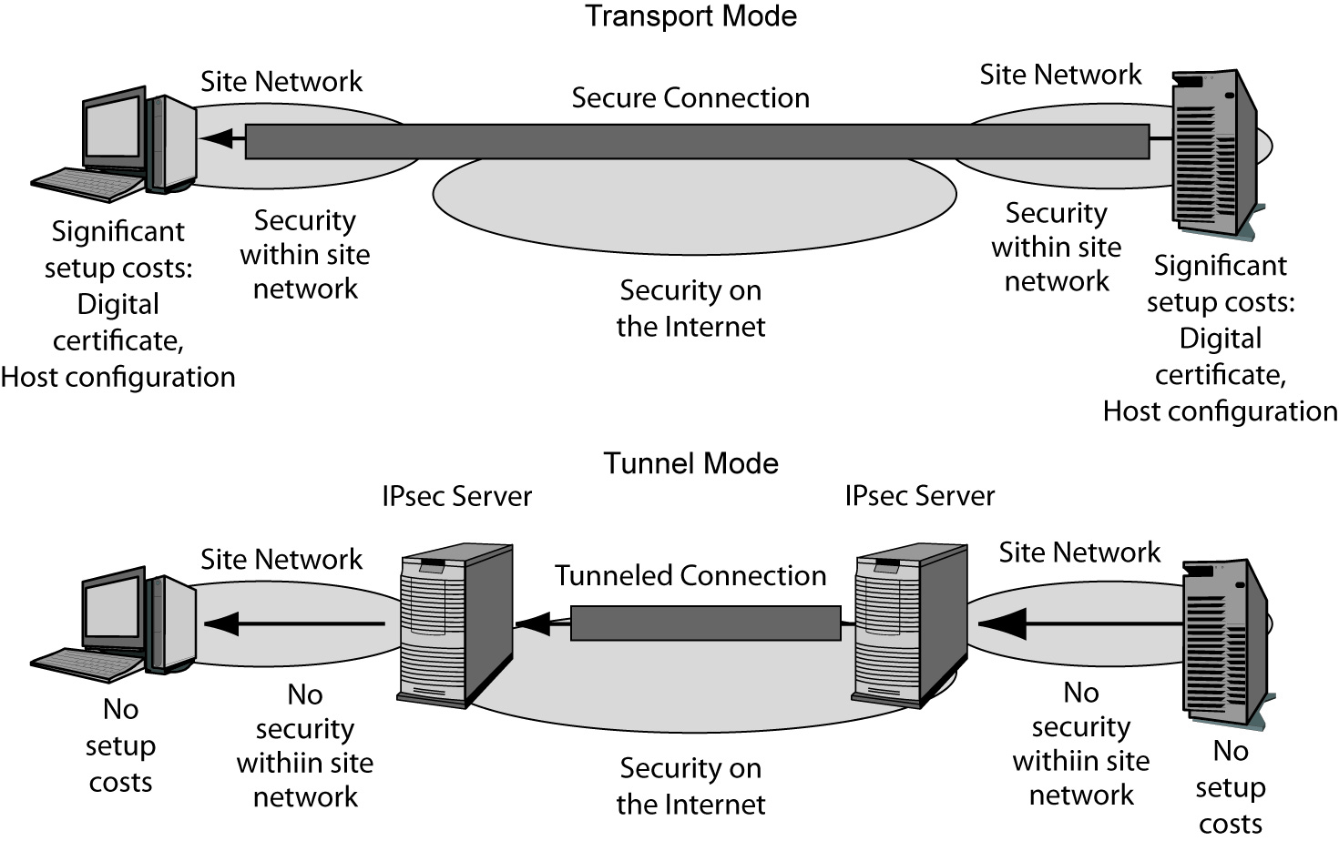
4-7: IPsec Operation: Transport Mode
1.
End-to-End
Security
(Good)
2.
Security in Site Network
(Good)
3.
Setup Cost
On Each Host
(Costly)

Slide 28
4-7: IPsec Operation: Tunnel Mode
2.
No Security in Site Network
(Bad)
3.
No Setup Cost
On Each Host
(Good)

Slide 29
IPsec Transport Mode
Host-to-host security
End-to-end protection
Cost of setup
IPsec in transport model and firewalls

Slide 30
IPsec Tunnel Mode
Protection is provided by IPsec gateways
Gateway-to-gateway protection
Less expensive than transport mode
Firewall-friendly protection
No protection within the two sites

Slide 31
4-8: Comparing IPsec Transport and Tunnel Modes
Characteristic | Transport Mode | Tunnel Mode
Uses an IPsec VPN Gateway? | No | Yes
Cryptographic Protection | All the way from the source host to the destination host, including the Internet and the two site networks. | Only over the Internet between the IPsec gateways. Not within the two site networks.
Setup Costs | High. Setup requires the creation of a digital certificate for each client and significant configuration work. | Low. Only the IPsec gateways must implement IPsec, so only they need digital certificates and need to be configured.

Slide 32
4-8: Comparing IPsec Transport and Tunnel Modes
Characteristic | Transport Mode | Tunnel Mode
Firewall Friendliness | Bad. A firewall at the border to a site cannot filter packets because the content is encrypted. | Good. Each packet is decrypted by the IPsec gateway. A border firewall after the IPsec gateway can filter the decrypted packet.
The “Bottom Line” | End-to-end security at high cost. | Low cost and protects the packet over the most dangerous part of its journey.

Slide 33
IPsec Headers
Two major security mechanisms:
Authentication header (AH)
Protects integrity, authenticity only
Encapsulating security payload (ESP)
Can provide:
Confidentiality
Data origin authenticity
Data integrity
Some replay protection
Limited traffic flow confidentiality

Slide 34
ESP
ESP can operate in one of two modes
Transport mode
Encapsulates upper-layer protocol frame
Provides end-to-end protection
Tunnel mode
Original IP datagram encapsulated within outer IP datagram (IP within IP)
Provides gateway-to-gateway security
* Wiley, 2008

Slide 35
ESP Packet Structure
* Wiley, 2008
Notes:
- Security Parameters Index (32 bits) Arbitrary value which is used (together with the source IP address) to identify the security association of the sending party.
- Sequence Number (32 bits) A monotonically increasing sequence number (incremented by 1 for every packet sent) to protect against replay attacks. There is a separate counter kept for every security association.
- Payload data (variable) The protected contents of the original IP packet, including any data used to protect the contents (e.g. an Initialisation Vector for the cryptographic algorithm). The type of content that was protected is indicated by the Next Header field.
- Padding (0-255 octets) Padding for encryption, to extend the payload data to a size that fits the encryption's cypher block size, and to align the next field.Pad Length (8 bits) Size of the padding in octets.
- Next Header (8 bits) Type of the next header. The value is taken from the list of IP protocol numbers.
- Integrity Check Value (multiple of 32 bits) Variable length check value. It may contain padding to align the field to an 8-octet boundary for IPv6, or a 4-octet boundary for IPv4.

Slide 36
ESP Packet Field
ESP packet
Header
Security Parameters Index (SPI)
Sequence number
Payload data
Trailer
Padding
Pad length
Next header
Authentication data
* Wiley, 2008

Slide 37
IPSec Example
See the posted pcap file: “ip-ipsec.pcap”
ESP SPI: ???
ESP Sequence: ???

Slide 38
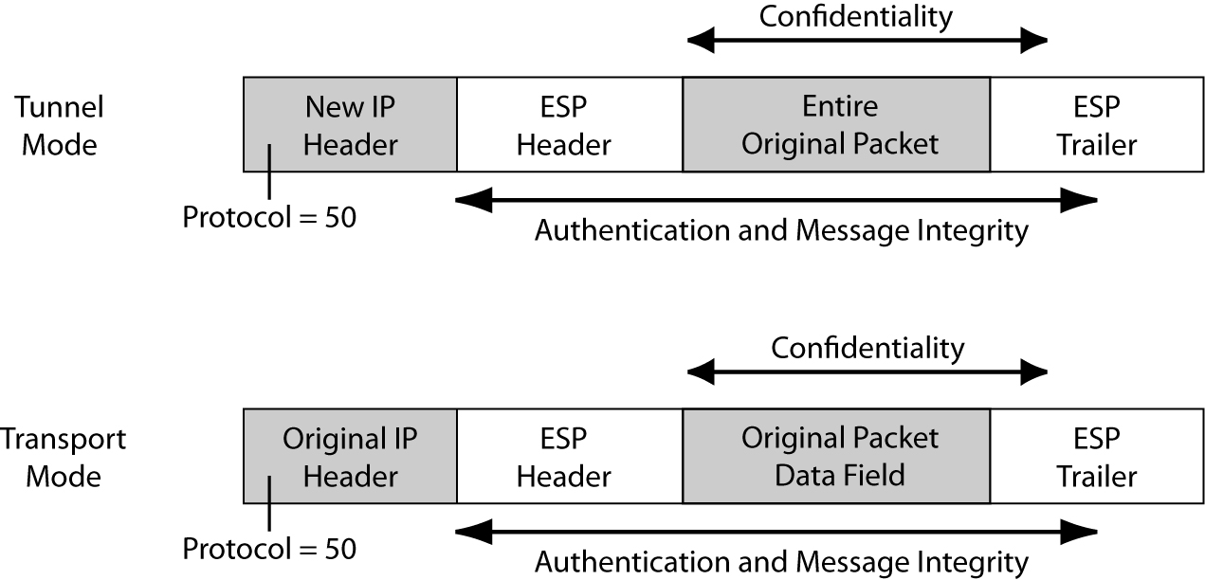
4-10: IPsec Encapsulating Security Payload (ESP) Header and Trailer in Transport and Tunnel Modes

Slide 39
Security Associations (SA)
Stores cryptographic data
Algorithm, key, key lifetimes
Enables system to generate, decrypt, verify ESP packets
Created in pairs
Two SAs required for bidirectional communication between two hosts
Uniquely identified by:
SPI (in AH and ESP headers)
Destination IP address
Security protocol (AH, ESP) identifier

Slide 40
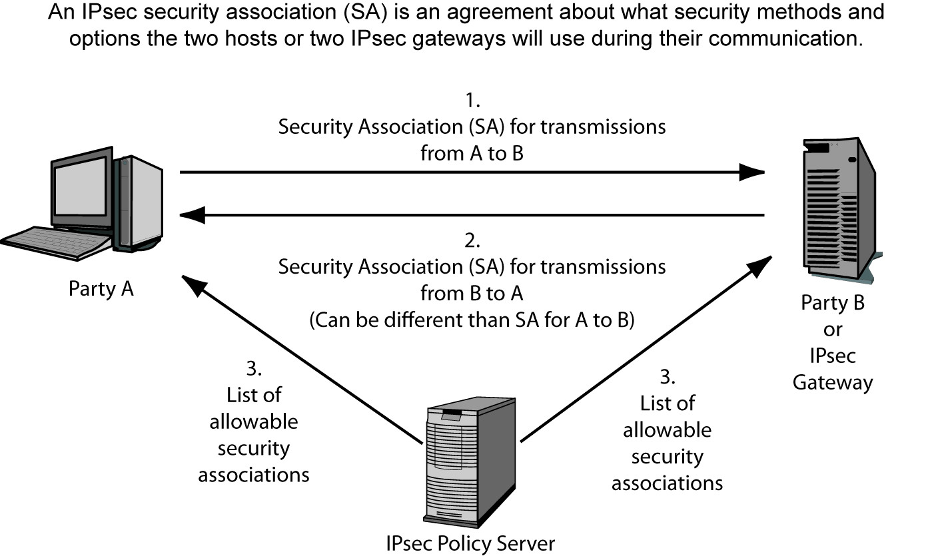
4-9: IPsec Security Associations

Slide 41
Internet Key Exchange Protocol (IKE; IKEv2)
Alternative to manually creating SAs
Provides for:
Entity authentication, establishment of fresh shared key, secure negotiation of all cryptographic algorithms
Phase 1: sets up an SA to carry further SA negotiation
Phase 2: SAs for general use are negotiated
Notes:
* http://en.wikipedia.org/wiki/Internet_Key_Exchange
IKE consists of two phases: phase 1 and phase 2.^{[10]}
IKE phase 1's purpose is to establish a secure authenticated communication channel by using the Diffie–Hellman key exchange algorithm to generate a shared secret key to encrypt further IKE communications. This negotiation results in one single bi-directional ISAKMP Security Association (SA).^{[11]} The authentication can be performed using either pre-shared key (shared secret), signatures, or public key encryption.^{[12]} Phase 1 operates in either Main Mode or Aggressive Mode. Main Mode protects the identity of the peers; Aggressive Mode does not.^{[10]}
During IKE phase 2, the IKE peers use the secure channel established in Phase 1 to negotiate Security Associations on behalf of other services like IPsec. The negotiation results in a minimum of two unidirectional security associations (one inbound and one outbound).^{[13]} Phase 2 operates only in Quick Mode.^{[10]}

Slide 42
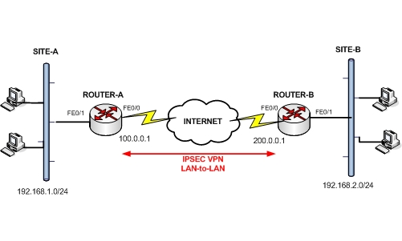


IPsec Vulnerabilities
Notes:
http://www.sersc.org/journals/IJAST/vol8/2.pdf
http://www.sans.org/reading_room/whitepapers/vpns/vulnerabilitys-ipsec-discussion-weaknesses-ipsec-implementation-pro_760

Slide 43
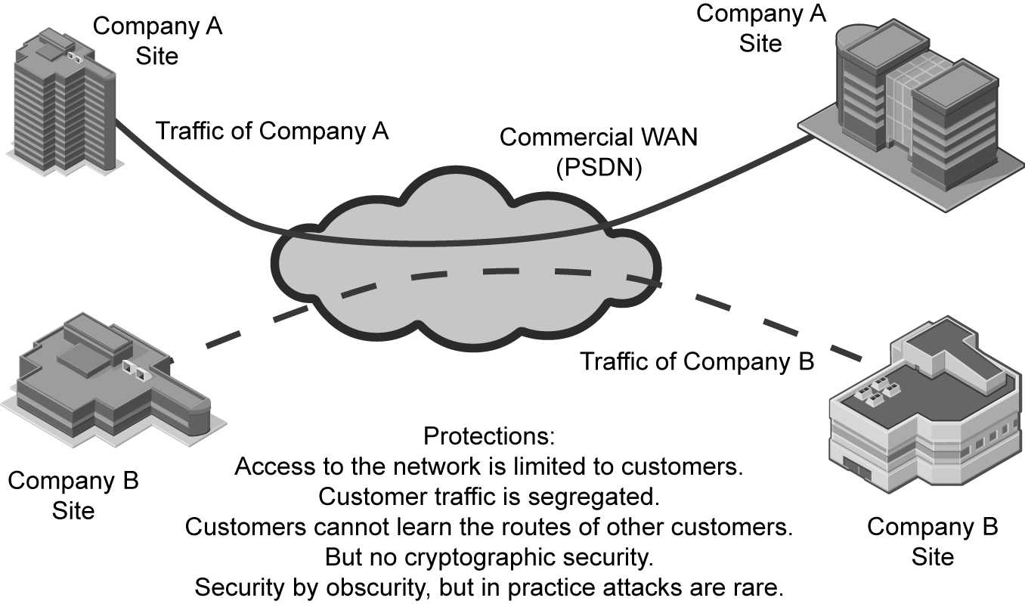
4-12: Protections in a Commercial WAN

Slide 44
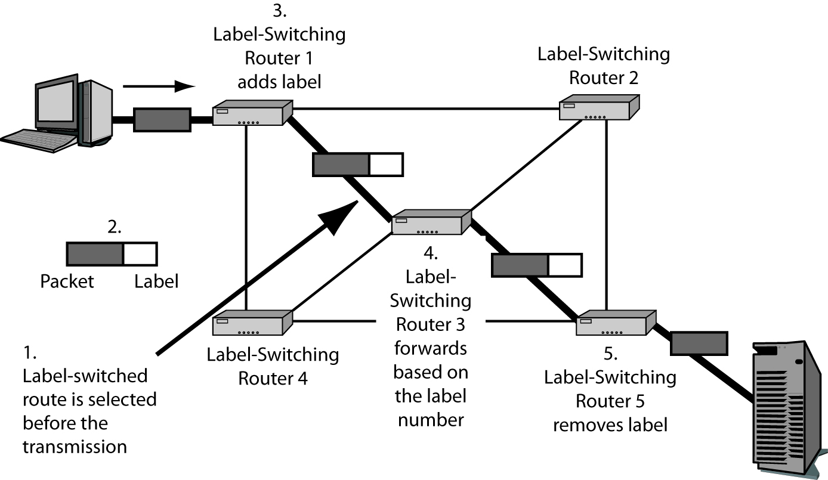
4-13: Multiprotocol Label Switching (MPLS) VPN
Router does not need to make a complex decision for each packet

Slide 45
4-14: Cryptographic versus Routed VPNs
 | Cryptographic VPNs | Routed VPNs
Examples | SSL/TLS IPsec | Carrier PSDNs Carrier TCP/IP MPLS VPNs
Cryptographic protections | Confidentiality, integrity, authentication, etc. | None
Other protections |  | Limiting customer access Limiting access to routing supervisory protocols
Customer actions to improve protection |  | Create a cryptographic VPN to run over carrier services

Slide 46
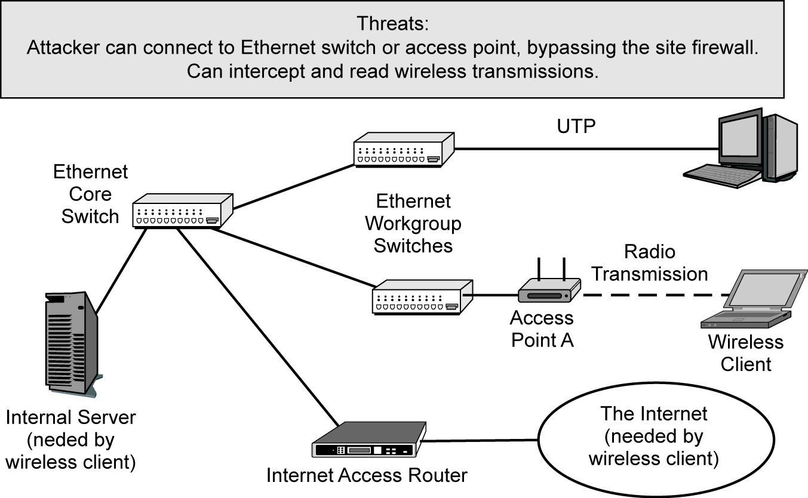
4-15: Corporate LAN

Slide 47
Ethernet Security
802.1X
Provides access control to prevent illegitimate clients from associating w/ a network
Called port-based access control because security is implemented on specific ports of an Ethernet workgroup switch
Central authentication server
Reduced cost
Consistency
Immediacy

Slide 48
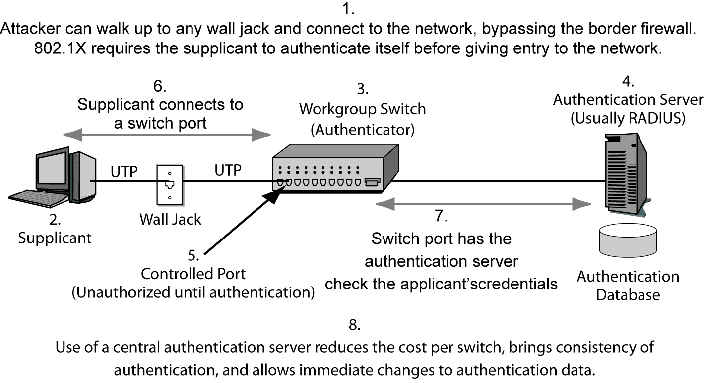
4-16: Ethernet and 802.1X

Slide 49
Extensible Authentication Protocol (EAP)
EAP operation
EAP Start
EAP Request and Response messages
EAP Success / EAP Failure messages
Extensibility
Easy to add new authentication methods to EAP (such as smart cards, MS-CHAP, Diffie-Helman, etc)
Software on the authenticator (workgroup switch) does not have to be changed. It merely passes request and response messages through

Slide 50
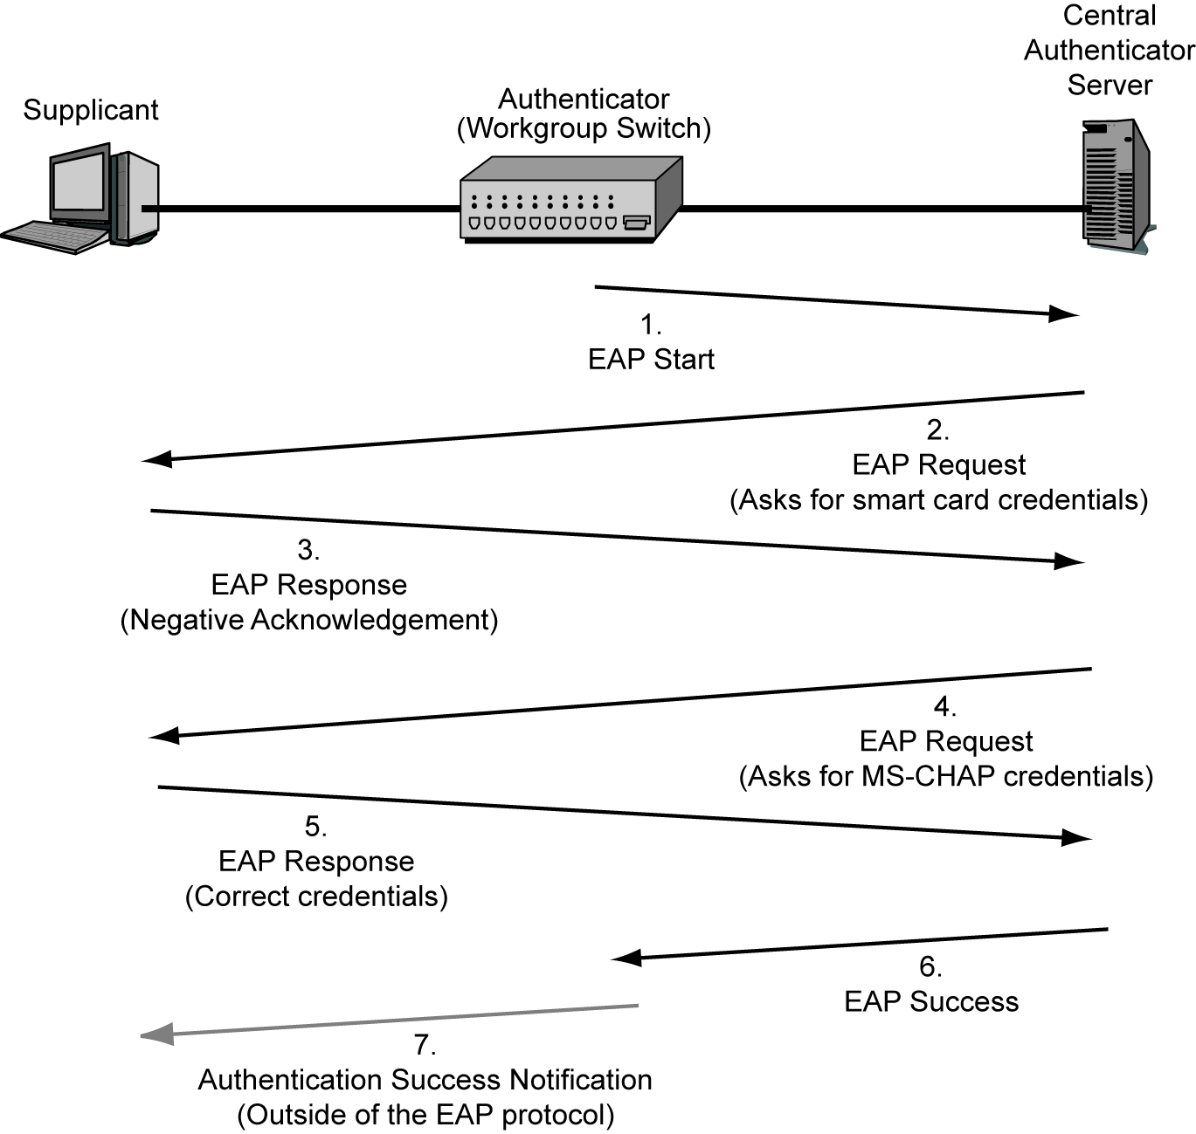
4-17: The Extensible Authentication Protocol (EAP)

Slide 51
4-18: RADIUS and EAP
RADIUS Functionality
Authentication | Authorizations | Auditing
Uses EAP | Uses RADIUS authorization functionality | Uses RADIUS auditing functionality

Slide 52
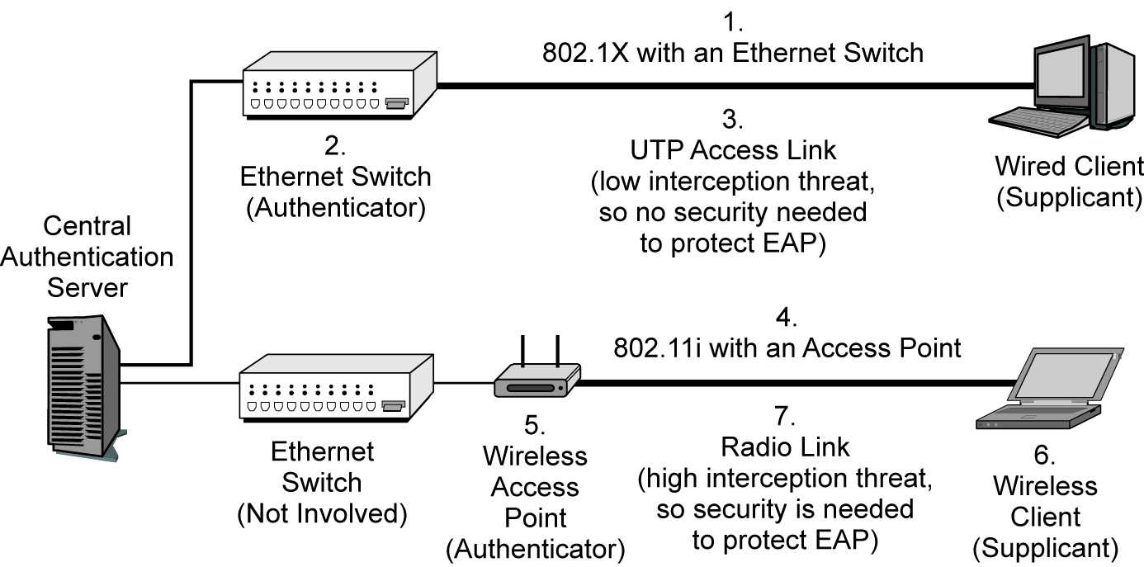
4-19: 802.11i or WPA Wireless LAN Access Control in 802.1X Mode

Slide 53
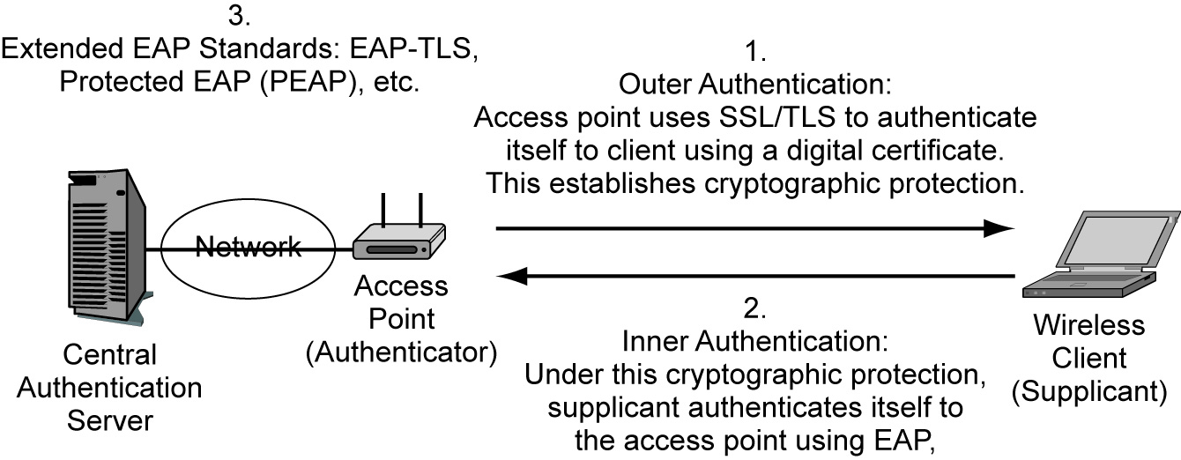
4-20: Extended EAP Protocols

Slide 54
4-21: 802.11 Core Security Protocol

Slide 55
4-22: 802.11
Cryptographic Characteristic | WEP | WPA | 802.11i (WPA2)
Cipher for Confidentiality | RC4 with a flawed implementation | RC4 with 48-bit initialization vector (IV) | AES with 128-bit keys
Automatic Rekeying | None | Temporal Key Integrity Protocol (TKIP), which has been partially cracked | AES-CCMP Mode
Overall Cryptographic Strength | Negligible | Weaker but no complete crack to date | Extremely strong

Slide 56
4-22: 802.11
Cryptographic Characteristic | WEP | WPA | 802.11i (WPA2)
Operates in 802.1X (Enterprise) Mode? | No | Yes | Yes
Operates in Pre-Shared Key (Personal) Mode? | No | Yes | Yes

Slide 57
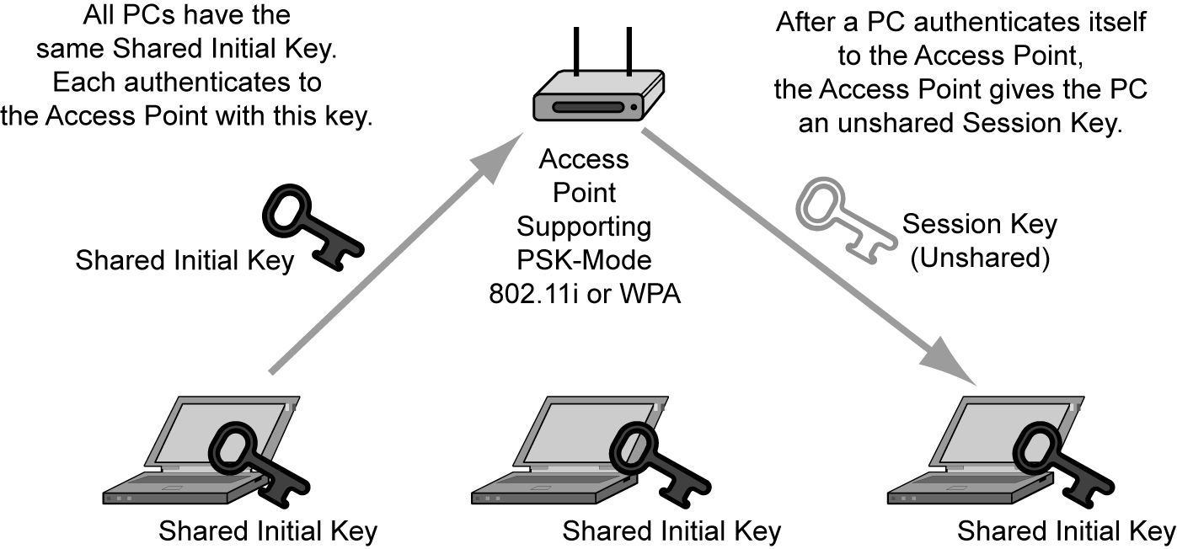
4-23: Pre-Shared Key (PSK)/ Personal Mode for 802.11i and EPA

Slide 58
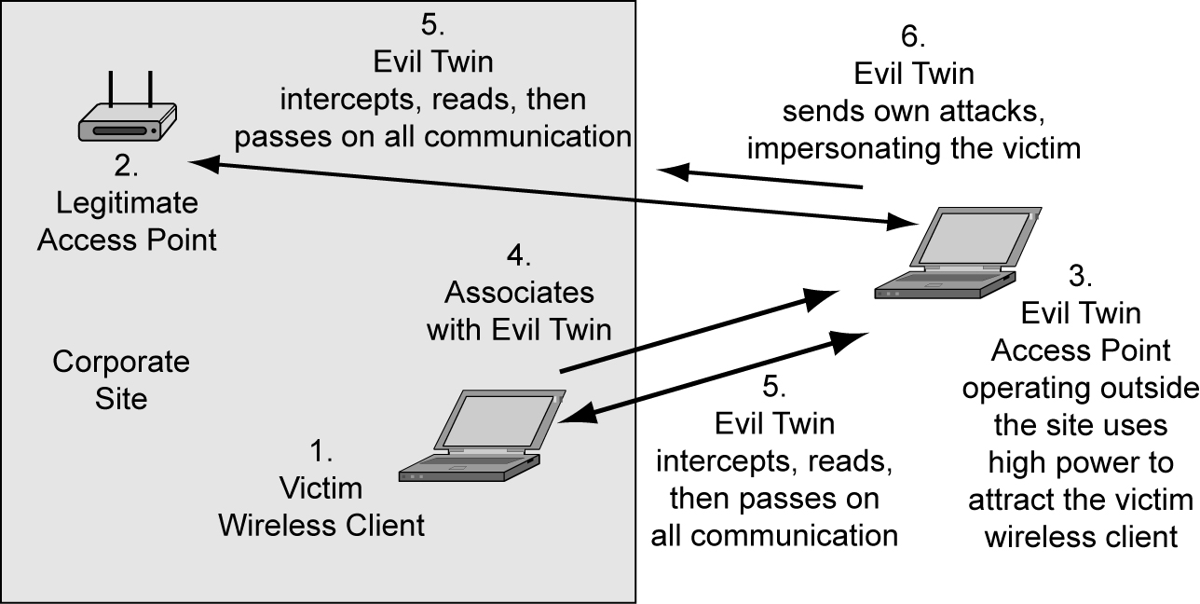
4-24: Evil Twin Access Point Man-in-the-Middle Attack

Slide 59
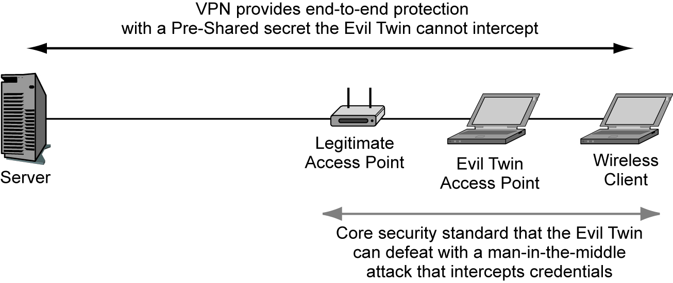
4-25: VPN Protection against Evil Twin Access Point Attacks

Slide 60
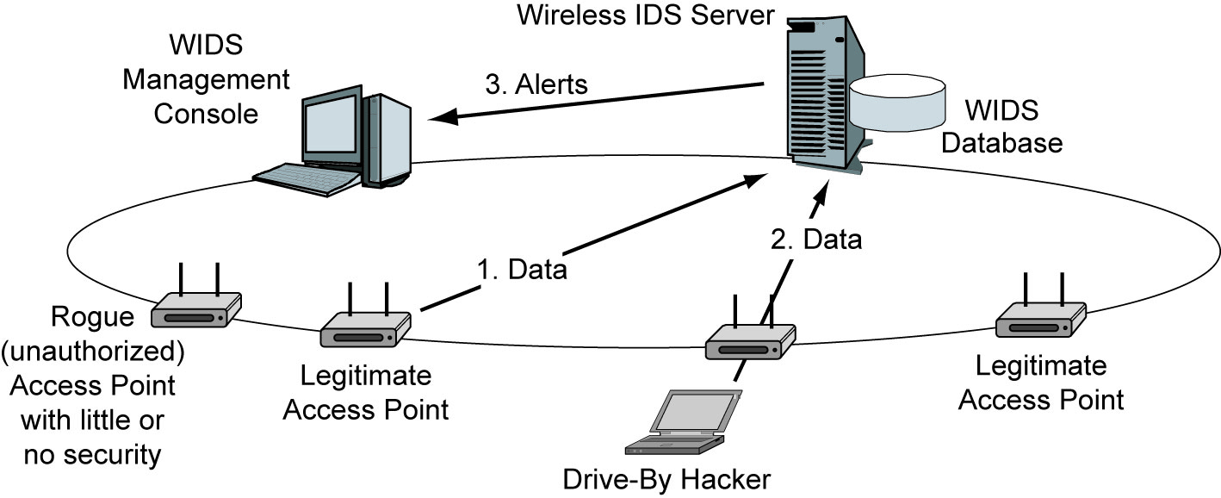
4-26: Centralized Wireless Intrusion Detection System

Slide 61
4-27: Wired Equivalent Privacy (WEP)
Origin of WEP
Original core security standard in 802.11, created in 1997
Uses a Shared Key
Each station using the access point uses the same (shared) key
The key is supposed to be secret, so knowing it “authenticates” the user
All encryption uses this key

Slide 62
4-27: Wired Equivalent Privacy (WEP)
Problem with Shared Keys
If the shared key is learned, an attacker near an access point can read all traffic
Shared keys should at least be changed frequently
But WEP had no way to do automatic rekeying
Manual rekeying is expensive if there are many users
Manual rekeying is operationally next to impossible if many or all stations use the same shared key because of the work involved in rekeying many or all corporate clients

Slide 63
4-27: Wired Equivalent Privacy (WEP)
Problem with Shared Keys
Because “everybody knows” the key, employees often give it out to strangers
If a dangerous employee is fired, the necessary rekeying may be impossible or close to it

Slide 64
4-27: Wired Equivalent Privacy (WEP)
RC4 Initialization Vectors (IV)
WEP uses RC4 for fast and therefore cheap encryption
But if two frames are encrypted with the same RC4 key are compared, the attacker can learn the key
To solve this, WEP encrypts with a per-frame key that is the shared WEP key plus an initialization vector (IV)
However, many frames “leak” a few bits of the key
With high traffic, an attacker using readily available software can crack a shared key in two or three minutes
(WPA uses RC4 but with a 48-bit IV that makes key bit leakage negligible)

Slide 65
4-27: Wired Equivalent Privacy (WEP)
Conclusion
Corporations should never use WEP for security

Slide 66
4-28: False 802.11 Security
Spread Spectrum Operation and Security
Signal is spread over a wide range of frequencies
NOT done for security, as in military spread spectrum transmission.

Slide 67
4-28: False 802.11 Security
Turning Off SSID Broadcasting
Service set identifier (SSID) is an identifier for an access point
Users must know the SSID to use the access point
Drive-by hacker needs to know the SSID to break in
Access points frequently broadcast their SSIDs

Slide 68
4-28: False 802.11 Security
Turning off SSID Broadcasting
Some writers favor turning off of this broadcasting
But turning off SSID broadcasting can make access more difficult for ordinary users
Will not deter the attacker because he or she can read the SSID,
which is transmitted in the clear in each transmitted frame

Slide 69
4-28: False 802.11 Security
MAC Access Control Lists
Access points can be configured with MAC access control lists
Only permit access by stations with NICs having MAC addresses on the list
But MAC addresses are sent in the clear in frames, so attackers can learn them
Attacker can then spoof one of these addresses

Slide 70
4-28: False 802.11 Security
Perspective
These “false” methods, however, may be sufficient to keep out nosy neighbors
But drive-by hackers hit even residential users
Simply applying WPA or 802.11i provides much stronger security and is easier to do

Slide 71

All rights reserved. No part of this publication may be reproduced, stored in a retrieval system, or transmitted, in any form or by any means, electronic, mechanical, photocopying, recording, or otherwise, without the prior written permission of the publisher. Printed in the United States of America.
Copyright © 2010 Pearson Education, Inc.
Publishing as Prentice Hall

